Slide 1
Testing
By: Amit Kumar
Project Group: Data Science Suite III

Slide 2
Why is software testing necessary?
Software Testing is necessary because we all make mistakes.
Point out the defects and errors that were made during the development phases.
It makes sure that the customer finds the organization reliable and their satisfaction in the application is maintained.
To ensure the quality of the product.
Too expensive to fix failures in later stages of development
Notes:
Point out the defects and errors that were made during the development phases.
It makes sure that the customer finds the organization reliable and their satisfaction in the application is maintained.
to ensure the Quality of the product.
It’s important to ensure that the application should not result into any failures because it can be very expensive in the future or in the later stages of the development.

Slide 3
Types of Software Development Tests
Unit tests
Integration Tests
Functional tests

Slide 4
Tips for Writing Better Unit Tests in Java
Use a framework for unit testing
Use Test Driven Development
Measure code coverage
Use assertions instead of print statements
Build tests that have deterministic results
Test negative scenarios and borderline cases, in addition to positive scenarios

Slide 5
Steps for development:
Design, write code, test
In testing steps:
Design, write code, write tests, run the tests

Slide 6
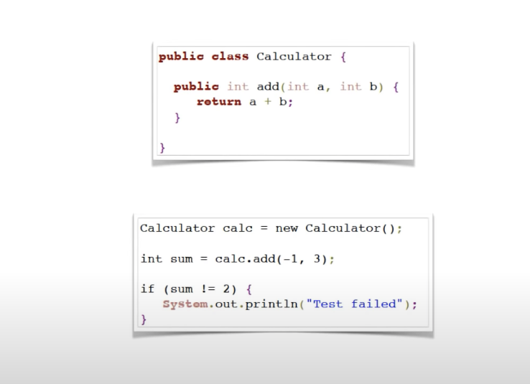
JUnit
Test Runs following are basic steps..
Preparation
Provide test inputs
Run the tests
Provide expected output
Verify result
Do something to alert if test failed
The things that are in bold are something that will always need to be done which is where Junit comes.

Slide 7
JUnit
It’s the standard for testing on Java. Junit5 is the newest iteration of this framework.
JUnit Framework can be easily integrated with either of the following −
Eclipse
Ant
Maven
Notes:
JUnit is a Regression Testing Framework used by developers to implement unit testing in Java, and accelerate programming speed and increase the quality of code. JUnit Framework can be easily integrated with either of the following −
Eclipse
Ant
Maven

Slide 8
Expectation vs reality
Create an instance of the class under test
Set up inputs
Execute the code you want to test
Verify the result is what you expect

Slide 9
Test-driven development
Test-driven development (TDD), is an evolutionary approach to development which combines test-first development where you write a test before you write just enough production code to fulfill that test and refactoring.
Coding
Testing (in the form of writing unit tests)
Design (in the form of refactoring).

Slide 10
Test-driven development
write a “single” unit test describing an aspect of the program
run the test, which should fail because the program lacks that feature
write “just enough” code, the simplest possible, to make the test pass
“refactor” the code until it conforms to the simplicity criteria
repeat, “accumulating” unit tests over time

Slide 11
Code coverage
Code coverage is a measurement of how many lines/blocks/arcs of your code are executed while the automated tests are running.
Jacoco
Parasoft JTest

Slide 12
Task
Write a simple code for palindrome detection using TDD with following conditions:
Test negative scenarios and exception cases, in addition to positive scenarios
Measure code coverage

Slide 13
Any questions or suggestions?

Slide 14
References
http://tryqa.com/why-is-testing-necessary/
https://www.tutorialspoint.com/junit/junit_test_framework.htm
https://www.youtube.com/watch?v=2E3WqYupx7c&list=PLqq-6Pq4lTTa4ad5JISViSb2FVG8Vwa4o
https://objectpartners.com/2010/12/21/how-to-write-junit-tests/
https://www.guru99.com/junit-assert.html
https://www.agilealliance.org/glossary/tdd/#q=~(infinite~false~filters~(postType~(~'page~'post~'aa_book~'aa_event_session~'aa_experience_report~'aa_glossary~'aa_research_paper~'aa_video)~tags~(~'tdd))~searchTerm~'~sort~false~sortDirection~'asc~page~1)
https://www.agilealliance.org/glossary/rules-of-simplicity/
https://stormpath.com/blog/7-tips-writing-unit-tests-java
http://www.agiledata.org/essays/tdd.html
https://medium.com/capital-one-tech/improve-java-code-with-unit-tests-and-jacoco-b342643736ed
https://www.youtube.com/watch?v=QDFI19lj4OM

Slide 15
Thank you

